Slide 1

First Come First Serve (FCFS) Scheduling Algorithm in Operating Systems
Presented by
Name - Aditya Kumar
Roll No. - 34230821034
Dept. – CSE(AI & ML)
Future Institute of Technology

Slide 2
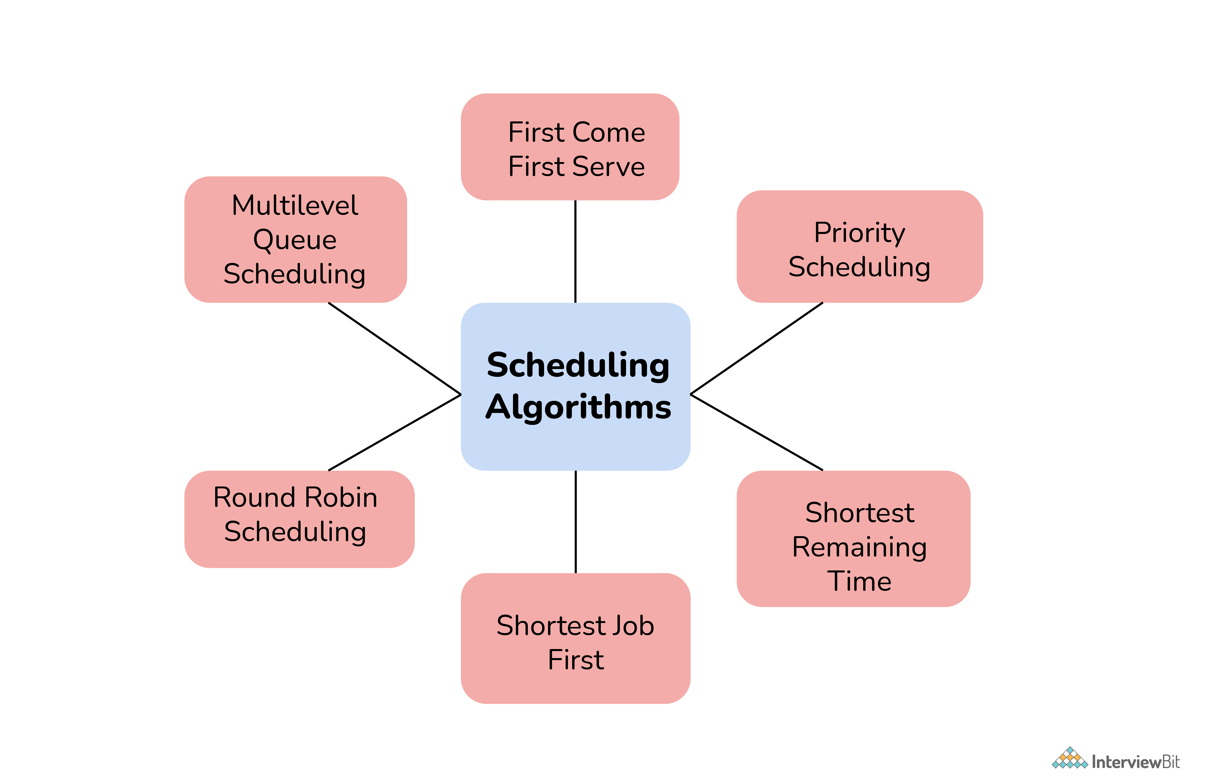
Introduction to Process Scheduling
Process Scheduling is responsible for selecting a processor process based on a scheduling method as well as removing a processor process.
CPU scheduling deals with the problem of deciding which of the processes in the ready queue is to be allocated the CPU.
There are many different CPU- scheduling algorithms. Out of which we are going to discover the First Come First Serve (FCFS) Scheduling algorithm.
ADITYA KUMAR, 34

Slide 3

2. Overview of First Come First Serve (FCFS) Algorithm
First Come First Serve CPU Scheduling Algorithm shortly known as FCFS is the first algorithm of CPU Process Scheduling Algorithm. In FCFS Algorithm what we do is to allow the process to execute in linear manner.
This means that whichever process enters the ready queue first, is executed first. This shows that FCFS Algorithm follows First In First Out (FIFO) principle.
It prioritizes tasks based on their arrival order, ensuring fairness in execution.
FCFS operates on a non-preemptive basis, meaning each task runs to completion before the next one starts.
ADITYA KUMAR, 34

Slide 4
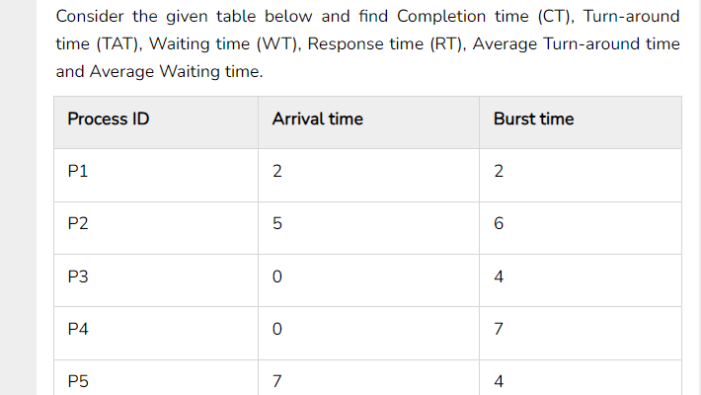
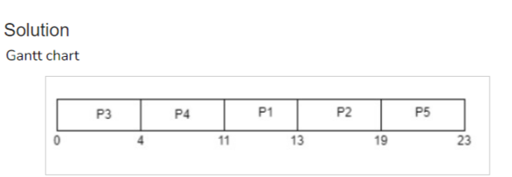
Example of FCFS Algorithm
Gantt Chart- is a bar chart that illustrates a particular schedule, including the start and finish times of each of the participating processes.
Arrival time (AT) − Arrival time is the time at which the process arrives in ready queue.
Burst time (BT) or CPU time of the process − Burst time is the unit of time in which a particular process completes its execution.
Completion time (CT) − Completion time is the time at which the process has been terminated.
Turn-around time (TAT) − The total time from arrival time to completion time is known as turn-around time. TAT can be written as,
Turn-around time (TAT) = Completion time (CT) – Arrival time (AT) or, TAT = Burst time (BT) + Waiting time (WT)

Slide 5
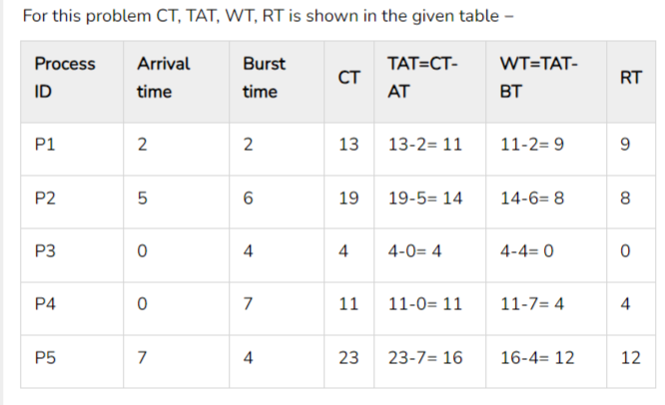
Waiting time (WT) − Waiting time is the time at which the process waits for its allocation while the previous process is in the CPU for execution. WT is written as Waiting time (WT) = Turn-around time (TAT) – Burst time (BT) Response time (RT) − Response time is the time at which CPU has been allocated to a particular process first time.
Average Waiting time = (9+8+0+4+12)/5 = 33/5 = 6.6 time unit (time unit can be considered as milliseconds)
Average Turn-around time = (11+14+4+11+16)/5 = 56/5 = 11.2 time unit (time unit can be considered as milliseconds)
ADITYA KUMAR, 34

Slide 6
3. Advantages & Disadvantages of FCFS Algorithm
Implementing the FCFS algorithm offers several advantages. Firstly, it is easy to understand and implement, requiring minimal computational resources. It ensures fairness in task execution, as tasks are processed in the order of their arrival FCFS is suitable for scenarios where short task lengths and non-preemptive execution are desired. By implementing FCFS, organizations can reduce workflow that leads to increased efficiency and customer satisfaction. It runs each procedure in the order that they are received. | While the FCFS algorithm offers simplicity and fairness, it also has its limitations. One major drawback is its inefficiency in handling long –running processes, as it may result in longer waiting times for subsequent tasks. FCFS does not prioritize task importance or deadline urgency, which can lead to missed deadlines in time-sensitive environments. FCFS CPU Scheduling favors CPU over Input or Output operations. In FCFS there is a chance of occurrence of Convoy Effect Because FCFS is so straight forward, it often isn't very effective. Extended waiting periods go hand in hand with this. All other orders are left idle if the CPU is busy processing one time-consuming order.
ADITYA KUMAR, 34

Slide 7
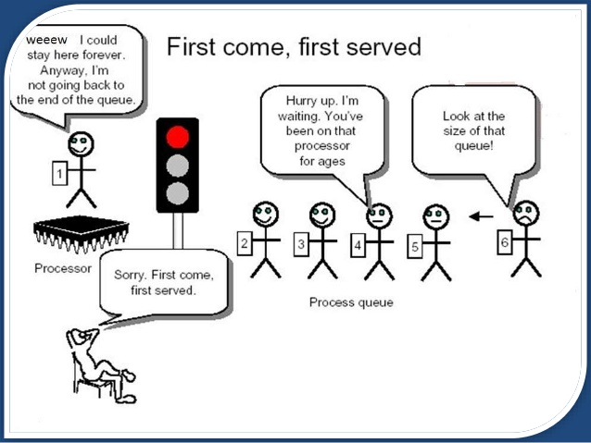
4.Real Life Example of FCFS Scheduling
As a real life example of FCFS scheduling a billing counter system of shopping mall can be observed. The first person in the line gets the bill done first and then the next person gets the chance to get the bill and make payment and so on. If no priority is given to the VIP customers then the billing system will go on like this (means the first person (first task) in the line will get the bill first and after finishing (executing) the first customer’s payment the counter boy(CPU) will pay attention to other customers (separate tasks) as they are in the line). As FCFS is non-preemptive type so no priority will be given to the random important tasks.
ADITYA KUMAR, 34

Slide 8

6. Conclusion
The First Come First Serve(FCFS) algorithm is a powerful method for optimizing process scheduling. It ensures fairness by prioritizing tasks based on their arrival time. While FCFS may not be the most efficient algorithm in all scenarios, it provided a simple and easy-to-implement solution. Understanding the strength and limitations of FCFS is crucial to effectively manage process scheduling and optimize operational efficiency.
THANK YOU!
ADITYA KUMAR, 34

